Slide 1
RATINGS PREDICTION PROJECT
By:
poojashree d s

Slide 2
Content:
Problem statement
Data pre-processing
Visualization
Model development and evaluation
Conclusions

Slide 3
Problem statement:
Missing ratings from products may result in the decrease in their popularity, most of the online shoppers view a product owing to its rating.
Rating is what attracts the first response. The aim of this problem is to generate ratings from the review text.
Ratings prediction and generation is a popular sentiment analysis application. It has wide spread use in e commerce platforms with missing ratings.

Slide 4
Data pre -processing
The data set consists of about twenty thousand entries with one feature column - Review and one target column - Rating.
The counts of different classes of target are obtained by .value_counts() method, it is clear that the data is balanced from the obtained output.
The data consists of one NaN value in the review column, we remove the row associated with it using dropna.
It is vital to convert all text data into lower cases to maintain the uniformity of words and to make sure that the model does not differentiate between capital and small letters.
Unnecessary characters that do not provide any information such as punctuations, numbers and stopwords are also removed.

Slide 5
Rare and common words in the text data are generated to get a general idea of the review emotion. Common words are generated with the help of Counter().
Some of the common words are- product, good, quality, nice, battery and sound. Some of the rare words are – compitable, keyboard, existed and prolific.
Tokenization is performed and the length of the text is computed in a new column.
We use Tfidf vectorizer to achieve vectorization.

Slide 6
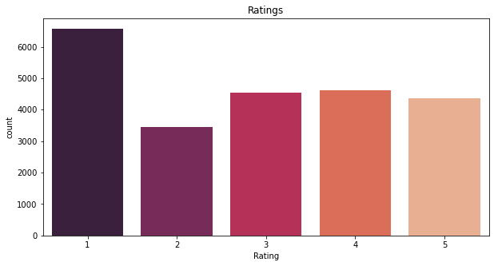
Visualizations: Count plot is used to get a grip on the number of entries in different classes of the target.
The target is fairly balanced with each class consisting approximately four thousand entries.

Slide 7
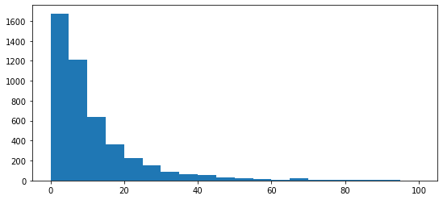
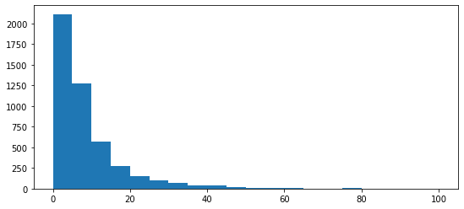
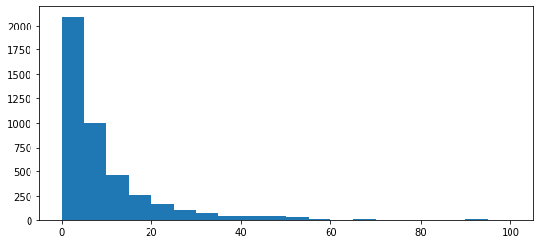
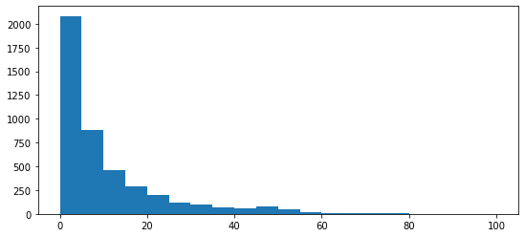
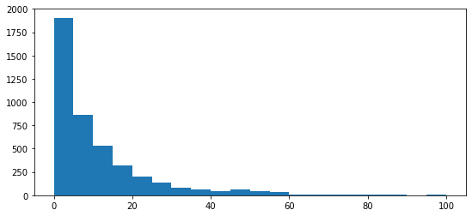
Histograms:
The number of words in in different star ratings are quite similar. The length peaks for the bin 0-20 in all classes. It can be gathered that length of a review has no impact on the rating of the product.

Slide 8
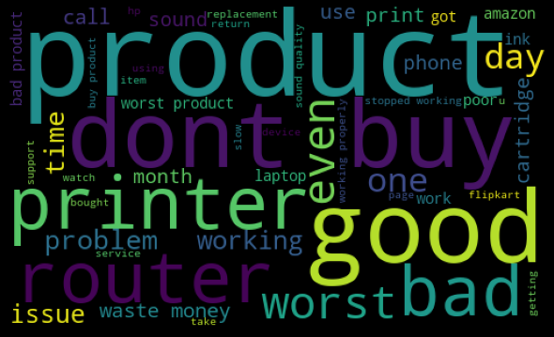
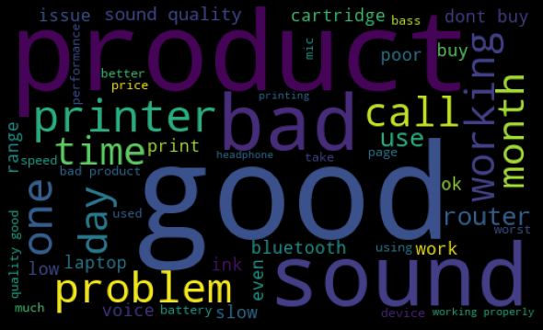
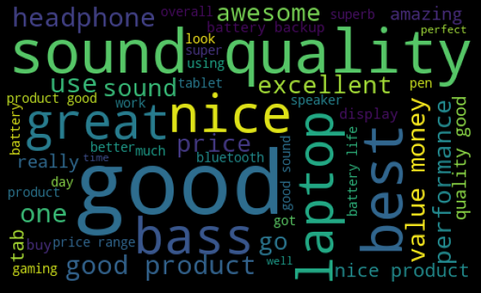
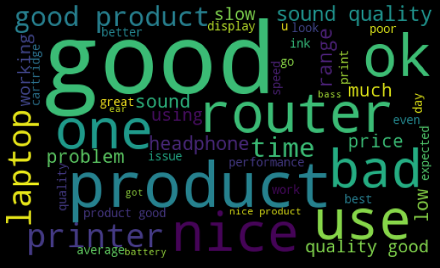
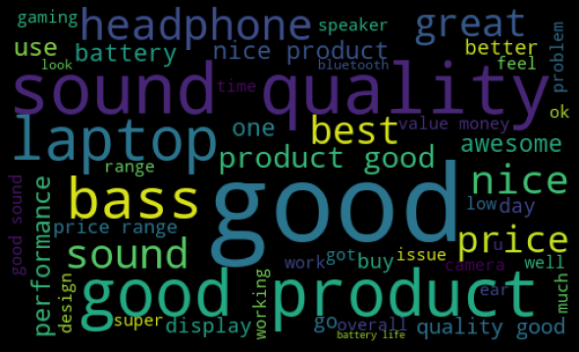
Wordcloud:
Wordclouds helps in recognizing the words which appear frequently. Recurrent words in each class of the target column are generated, we see that there are common loud words in all star rating which hints at the performance of the model.

Slide 9
Model development and evaluation:
Both high bias and high variance models can be considered due to the nature of the dataset.
MultinomialNB, Decision tree classifier and SVM classifier are employed in this problem.
SVM is selected as the final model after looking at the performance metrics.
The key metrics used are accuracy score, classification report and confusion matrix.
Gridsearch CV is used for hyperparameter tuning.

Slide 10
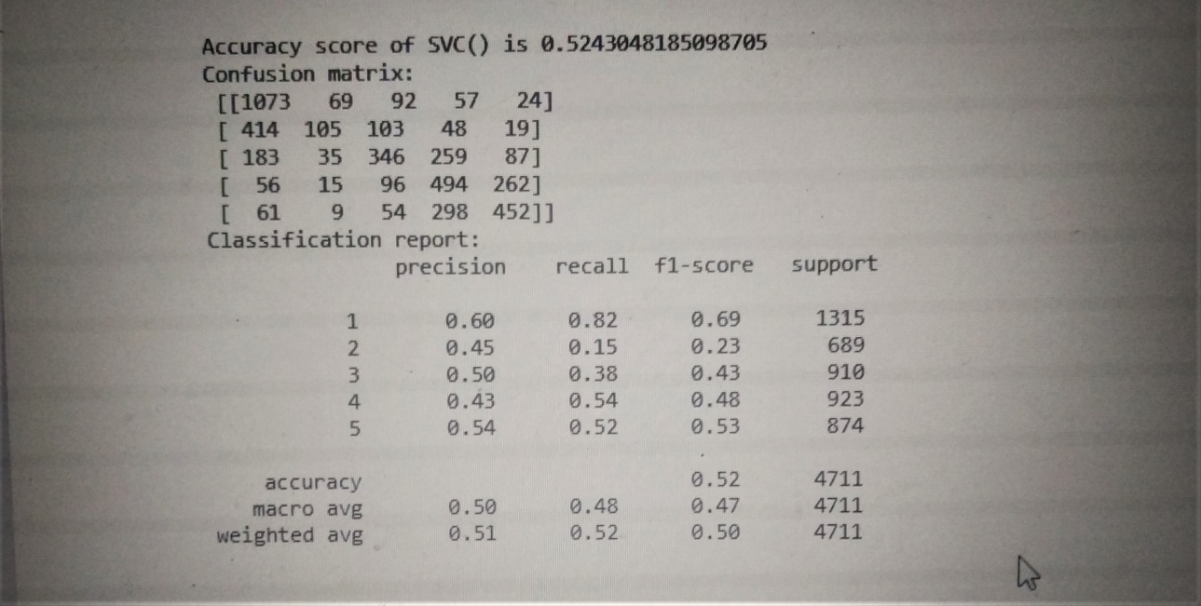
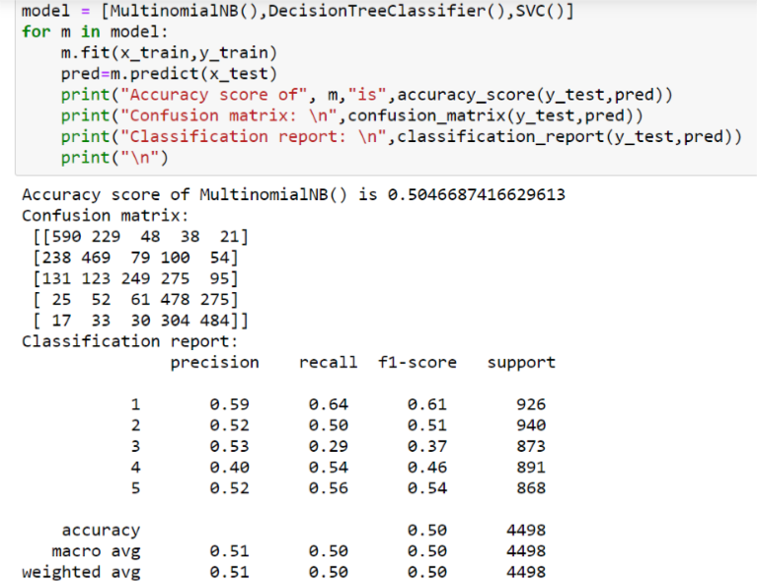
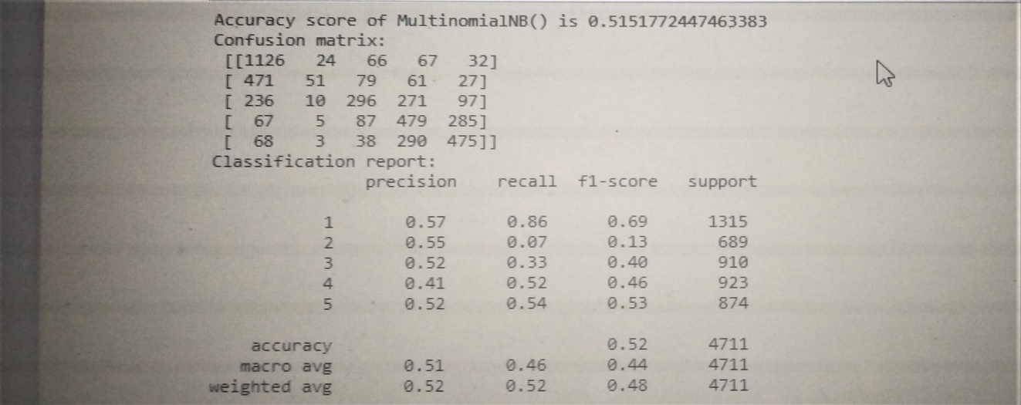
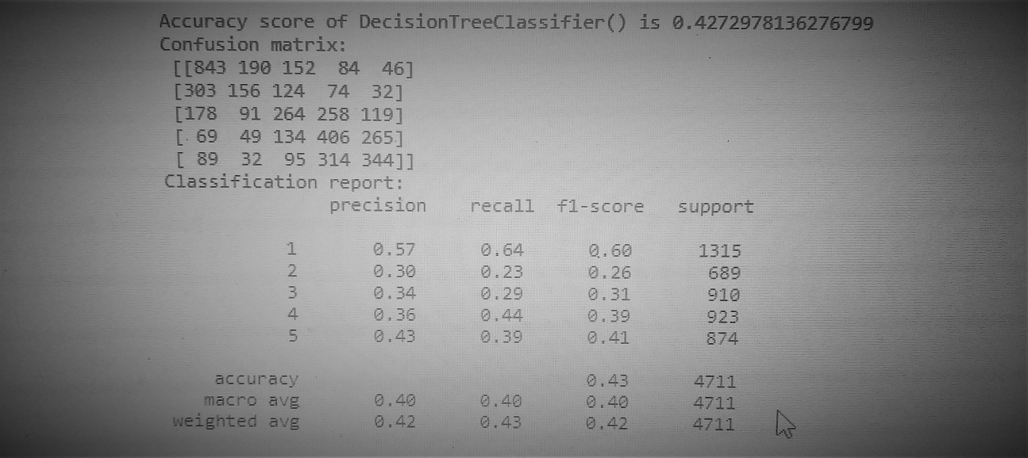
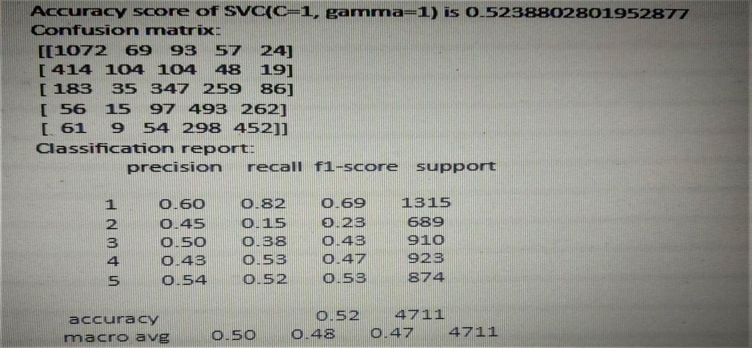
Gridsearch CV is applied on SVM to obtain a better version of the algorithm. The best parameters yielded from Gridsearch CV are:
{'C': 1, 'gamma': 0.1, 'kernel': 'rbf'}

Slide 11
Conclusions:
The most suitable model for this problem comes out to be SVM classifier. The accuracy score of 0.52 can only be considered as an average performance.
The model is not able to predicted the star ratings well, it is clear from this that the data scraping phase must include much more entries with diversified background to avoid noise.
The length of a review does not influence the nature or the star category of a rating.
There are common loud words in all star ratings which hints at the performance of the model.

